Slide 1
Circle of Security in the Classroom (COSP-C)
Susan Williams

Slide 2
The Early Life Matters Team (ELM)
The ELM Team provides therapeutic counselling for caregivers who have concerns either about their relationship with their child or their child's feeling or behaviours.
The Team utilizes Circle of Security (COS) to focus on the attachment relationship between a caregiver and their child (aged 0-12).
We are a multidisciplinary team of 6 part time social workers, psychologists and counsellors.
Based at Narrabundah

Slide 3
Who the program supports
Any family with children aged 0-12 years old who are worried about:
How they have bonded with their child
Understanding or managing their child’s emotions and / or behaviours
The impact of difficult family circumstances such as family mental health issues, family violence, trauma, grief and loss, and separations on the caregiver’s capacity to parent
How the child is adjusting to family change, separations and transitions
Parenting Stress

Slide 4
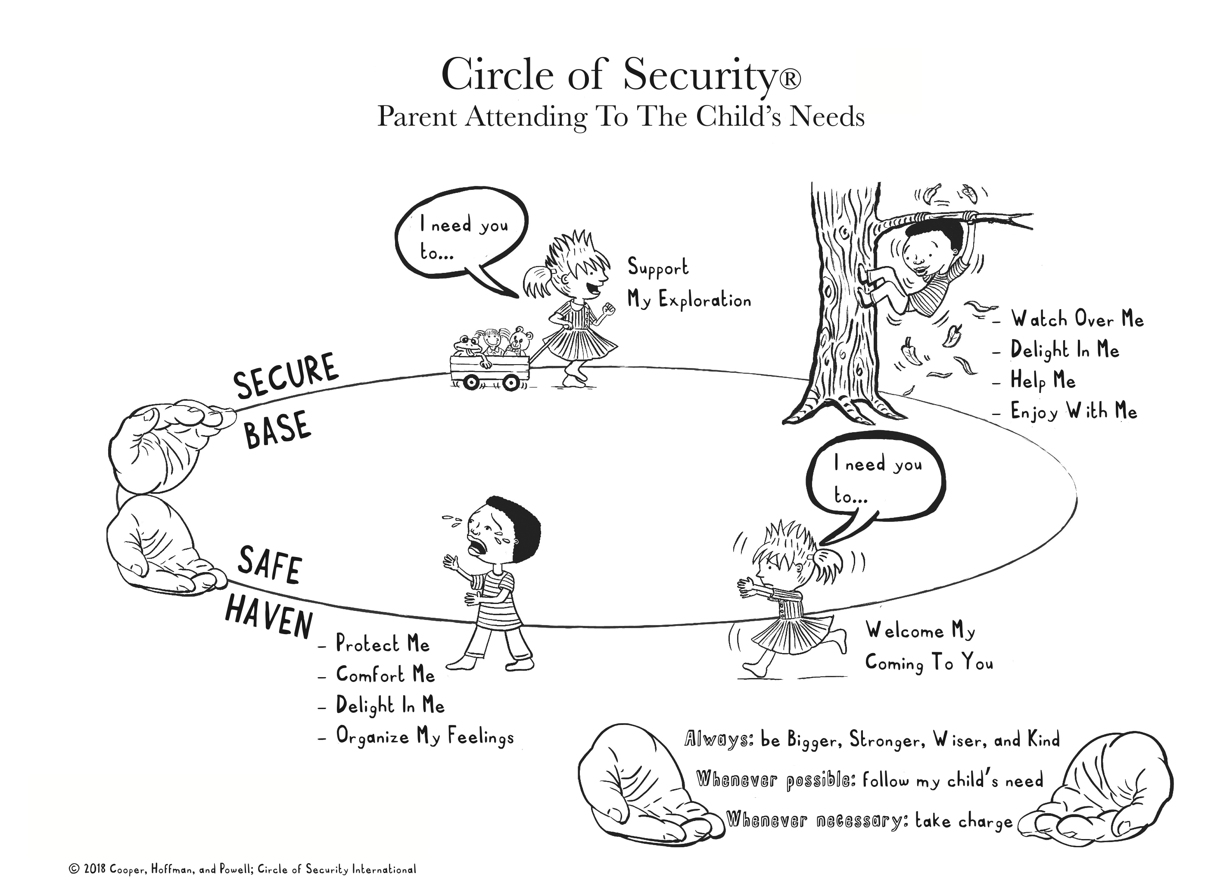

Slide 5
The Programs
Circle of Security Parenting (COSP) - 8 week program delivered primarily in a group format
Circle of Security Intensive (COS-I) - 20 week program delivered in both individual and group format
Circle of Security Classroom (COSP-C) 8 week program delivered in a group format

Slide 6
Circle of Security Classroom (COSP-C)
An 8 week professional development training program delivered in a group format to early childhood educators and primary school teachers
We believe we are the only service in Canberra providing this program
Piloted in term 1 and 2 2023 for childcare providers
In term 3 we took this program for the first time into a primary school setting at Lyons Early Childhood School. All teachers and school executives participated.
Lyons will become the first site where we are working towards training all teachers, childcare educators and staff across both the school, ELC and Out of School Care Program to ensure a consistent and shared framework for children 0-8.

Slide 7
What is COSP-C
When children feel safe and secure, learning happens. So, it makes sense, and is supported in the research, that promoting secure relationships with early care professionals is critical to children's success in school.
COSP Classroom invites teachers to consider themselves as attachment figures to children in their care.
COSP Classroom is a model to enhance teachers’ abilities to form secure relationships with the children in their care
Through video observation and self reflection, early care professionals learn relationship-based strategies to respond to the children’s social emotional needs for safe, secure relationships in the classroom.

Slide 9
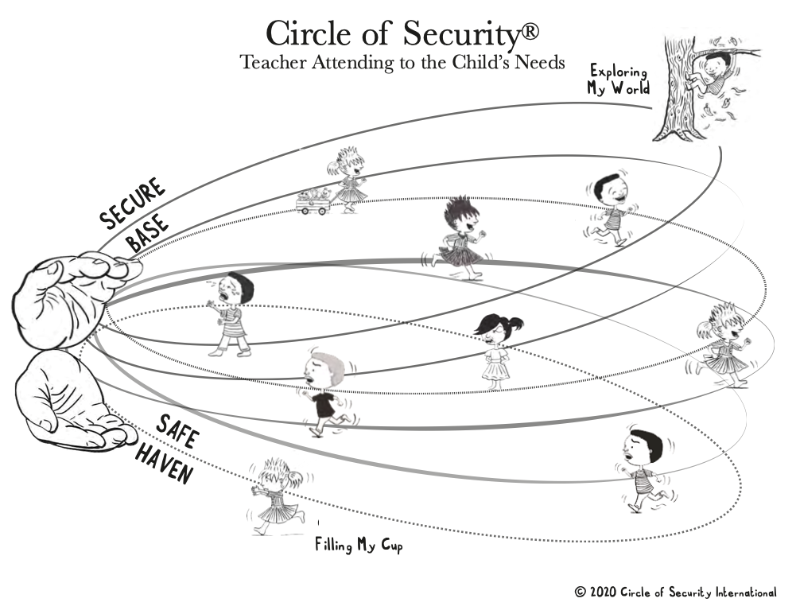

Slide 11
The teacher as the hands
Strong
Kind
Committed
Experience each child as an individual
Accept the child as they are
Being emotionally available
Own your influence on the child’s psychological, emotional, social, cognitive and physical development
Provide warmth, care and attuned presence
Able when necessary to set limits, provide comfort and offer protection

Slide 12
Outcomes
The program provides the opportunity to reflect on invisible children in the classroom and care setting.
It helps educators and teachers understand where a child is on the circle and if it is the bottom, it gives them a framework to support that child to move back to the top of the circle where learning and play can happen.
It provides an understanding of difficult behaviours and clear strategies for addressing those behaviours.
It supports the development of confidence within the educator or teacher to feel capable and successful in supporting the children in their care and their learning and development.
It provides a clear framework to support transitions into and out of care / school for the child, parent and educator / teacher.

Slide 13
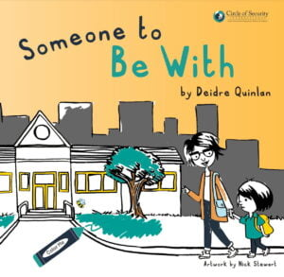
Transitions
Coming and Going in Childcare School / The Rowboat Metaphor
‘Someone to Be With’ Book

Slide 14
For more information
Any questions, please contact Susan Williams
Susan.Williams@mccg.org.au
6162 5827

